Slide 1

Forecasting Electrical Energy Consumption
Presented By: -
Marmik Parashar, Vansh Sachdeva, Ayushi Dadhich, Shashwat Mishra
Under Guidance Of: -
Mr Anurag Singh, Project Engineer CDAC Delhi

Slide 2
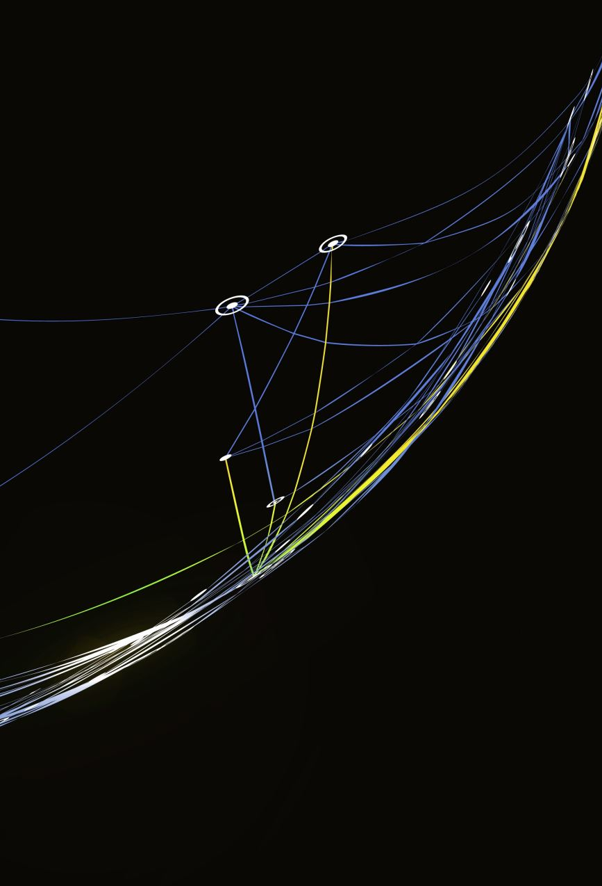
Abstract
This project develops an advanced electricity consumption forecasting model using ML techniques like ARIMA, SARIMA, and TBATS. It enhances accuracy by capturing non-linear energy patterns influenced by economic, climatic, and global factors. Key aspects include data augmentation, feature engineering, and a scalable, adaptable approach. The final model is deployed via a web interface to support efficient energy management.

Slide 3

objective
The project aims to develop an advanced electricity consumption forecasting model using ML techniques like ARIMA and SARIMA to enhance prediction accuracy and adaptability. By analyzing large datasets and incorporating synthetic data generation and feature engineering, it ensures scalability and reliability across diverse geographical, economic, and climatic conditions, supporting efficient energy management.

Slide 4

Hardware and Software Requirements
• Hardware:
Processor: Intel i7 (8th Gen) or AMD Ryzen 7
RAM: 12GB DDR4
Storage: 100GB SSD
GPU: WhiskeyLake-U GT2 [UHD Graphics 620]
• Software:
OS: Linux, Windows 11 Home
Text Editors: Vscode, Anaconda Jupyter
Data Visualization: Power BI, Spreadsheet Viewer
Browser: Google Chrome or compatible browser

Slide 5
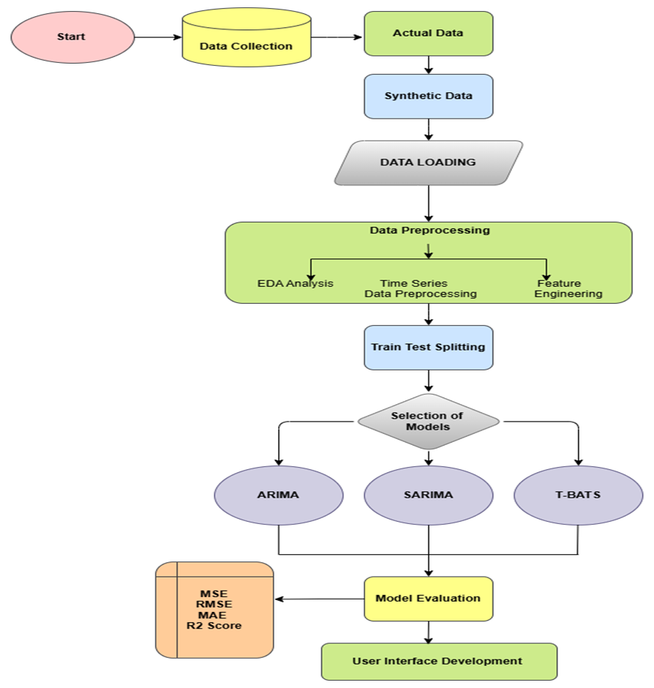
Data Flow Diagram

Slide 6
Work Distribution
Ayushi Dadhich and Shashwat Mishra – Data-Preprocessing, EDA, Bi-Dashboard Creation
Vansh and Marmik – Machine Learning model creation (ARIMA SARIMA and TBATS) And Web UI Development

Slide 7
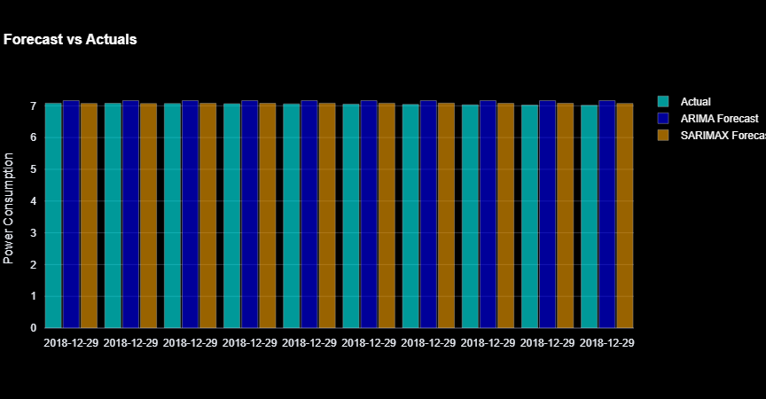
Result Analysis
Model Name | Mean Square Error | Mean Absolute Error | Root Mean Squared Error | R-squared
ARIMA | 0.095 | 0.274 | 0.309 | -3.389
SARIMA | 0.095 | 0.274 | 0.309 | -3.39
TBATS | 0.026 | 0.013 | 0.016 | -0.381

Slide 8
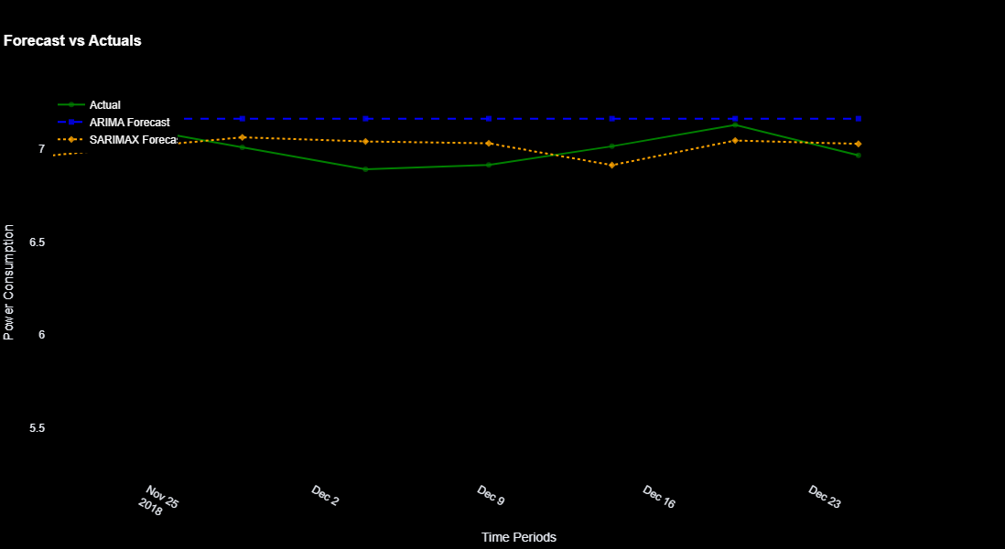
Comparison Of ARIMA-SARIMA Predictions vs Actual Values

Slide 9
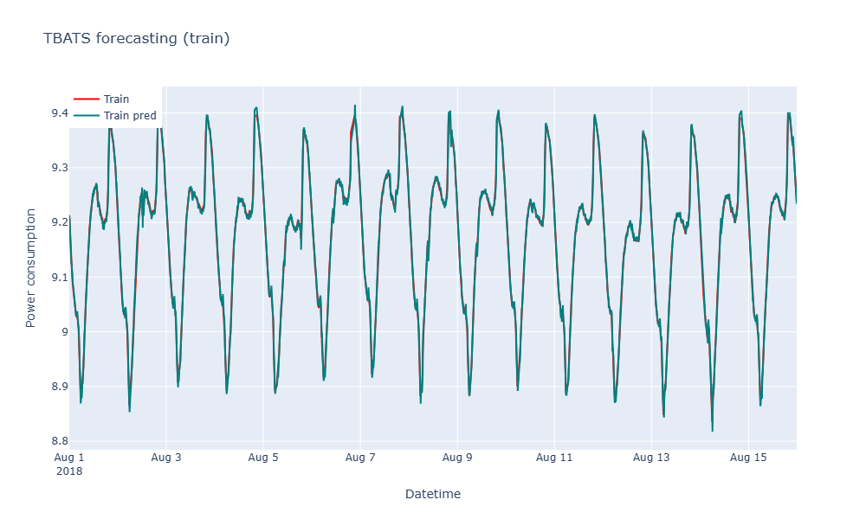
TBATS Forecasting

Slide 10
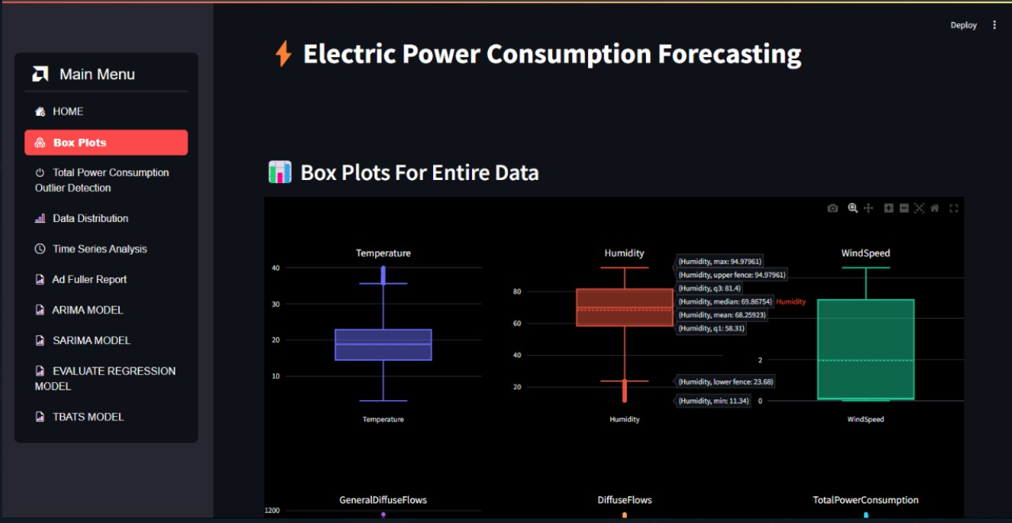
Web UI Interface

Slide 11
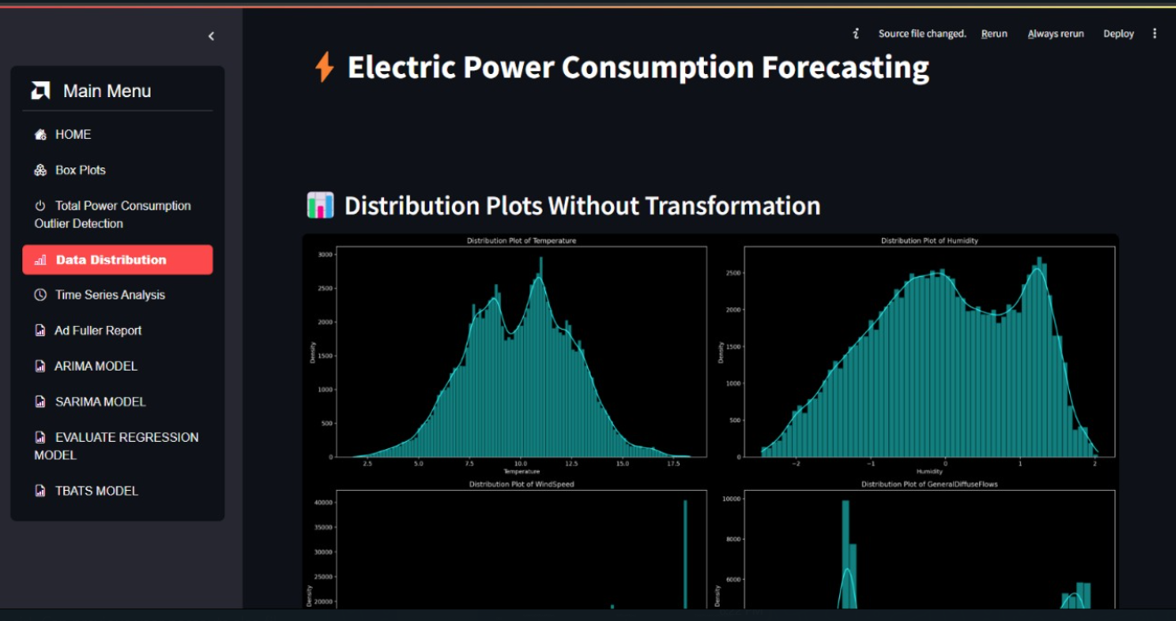

Slide 12
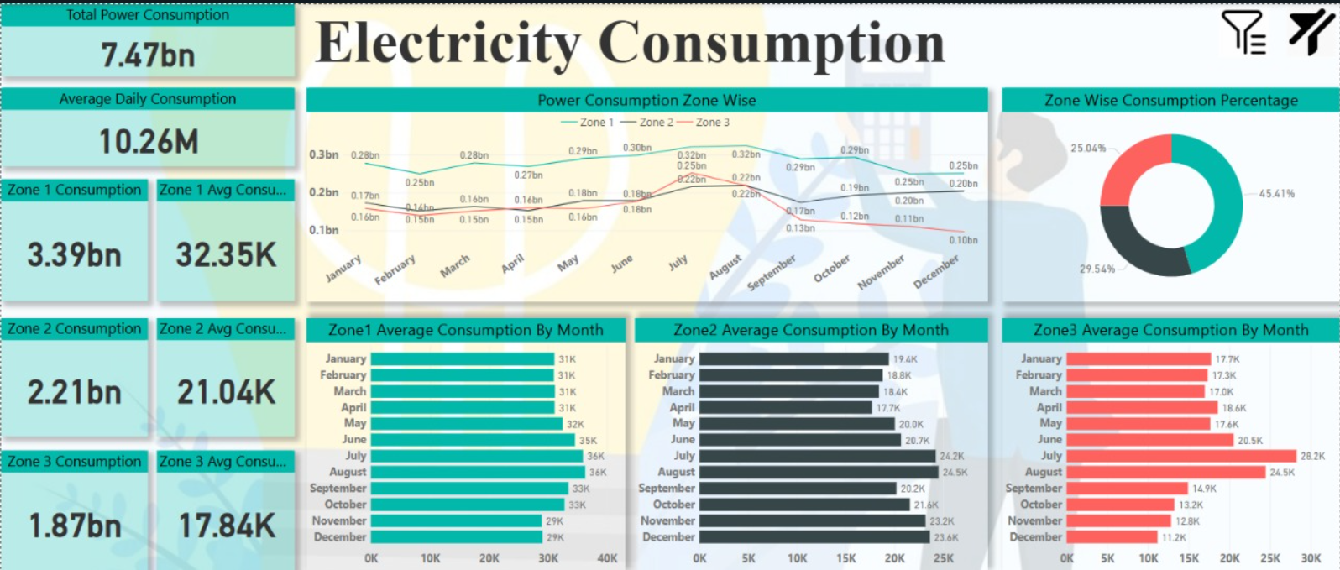
Power BI Dashboards

Slide 13
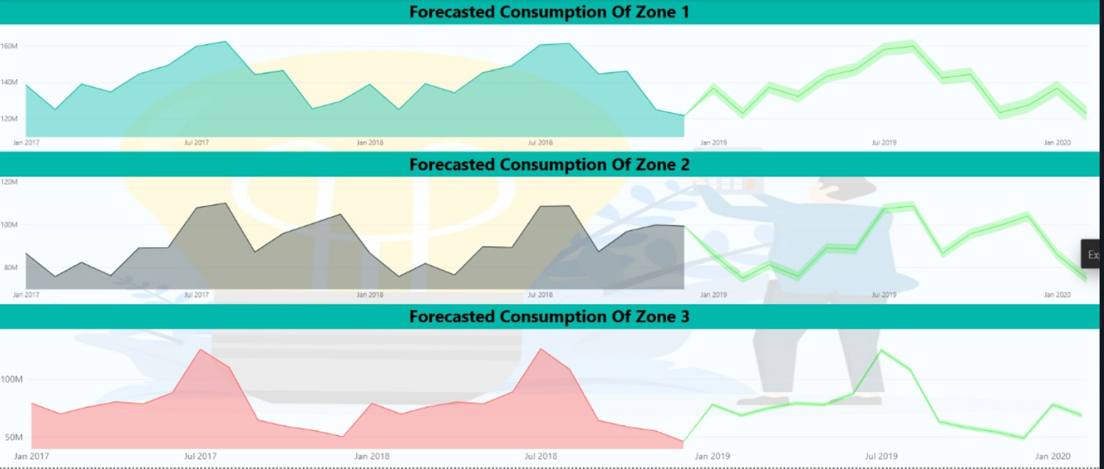
Power BI Forecasting Dashboard

Slide 14

Thank You

